Slide 1
Bus-based Fabric
Anuparna Ganguly
16/02/2026

Slide 2
Bus -> DIE0 Latency
Concern
The Bus -> DIE0 path has a fixed 19 cycle delay.
In FlexNoC only Arbiter primitive has zero_load_latency attribute.
Multiple packets may have DIE0 as destination, requiring arbitration.
An arbiter is needed before accessing DIE0.
Assumption
We incorporate the fixed cycle delay into the zero-load latency term.
Assuming DIE0 has arbitration.
Packets coming from BF0 buffer are arbitrated by the DIE0 arbiter after arbitration packets waits at DIE0 buffer and finally delivered to sink.

Slide 3
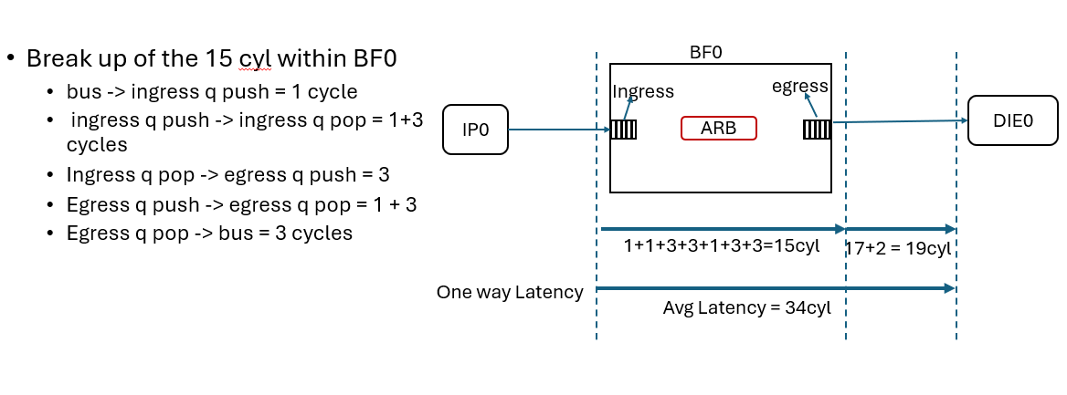
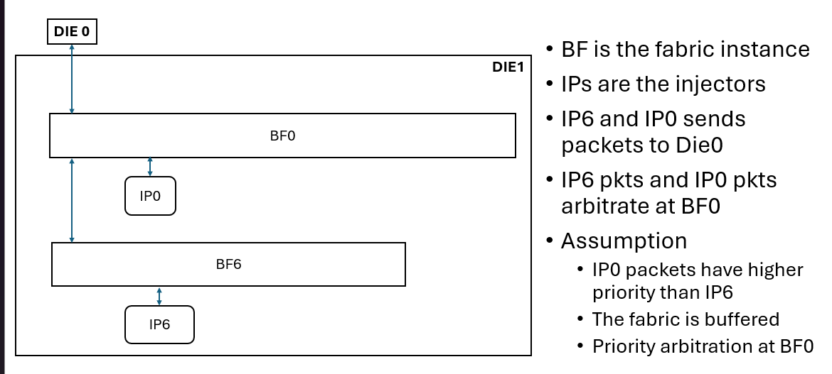
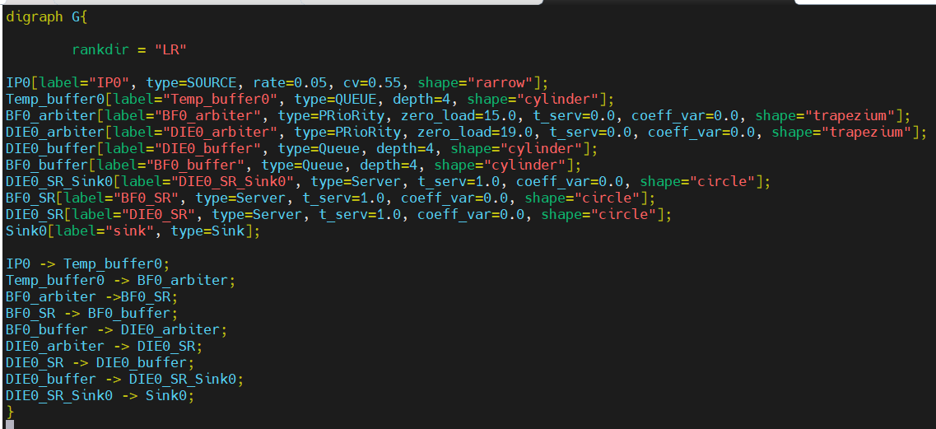

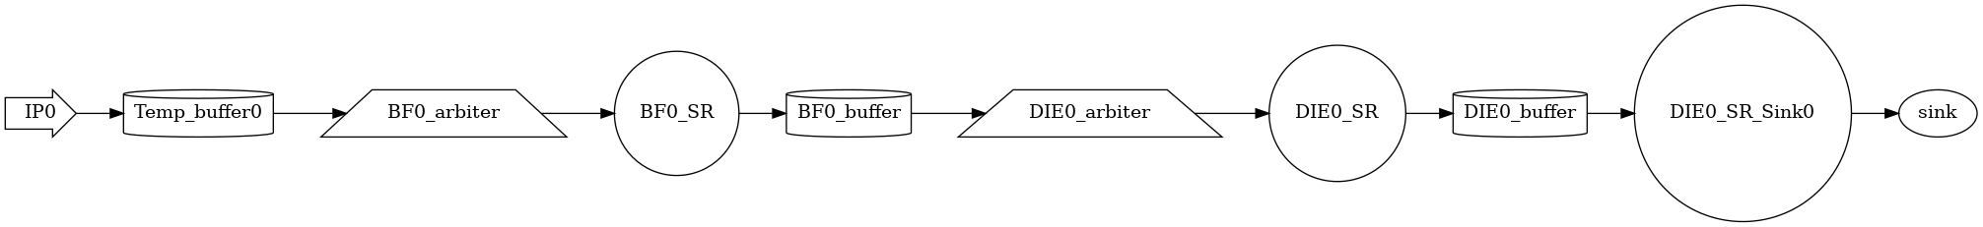
Experiment 1 : IP0->BF0->DIE0; NO IP6
IP6 is inactive and doesn’t send any packets into the fabric
o/p from FlexNoC
.dot input file
Autogenerated png file

Slide 4
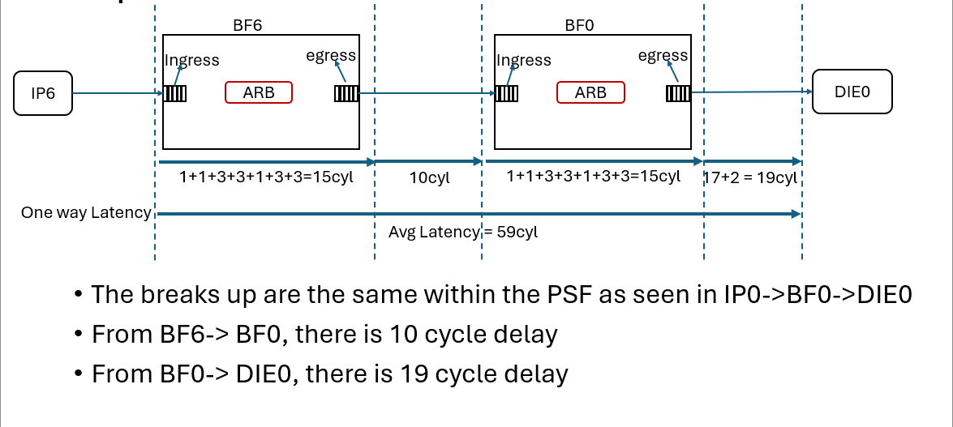
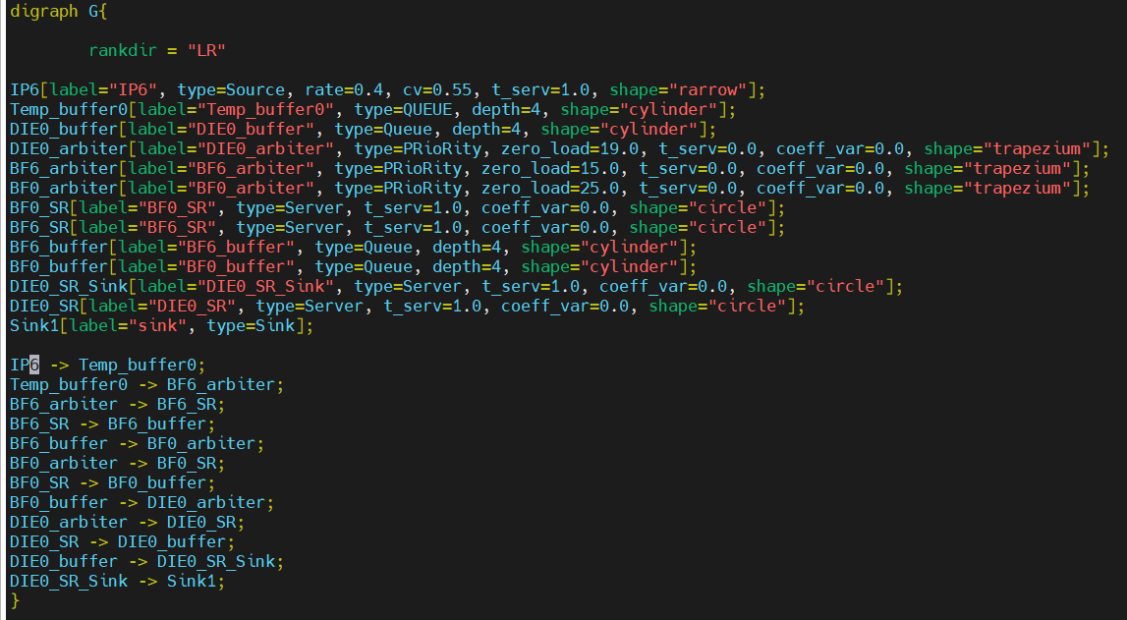
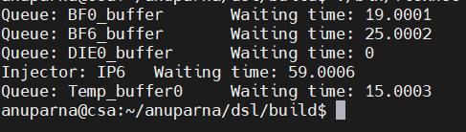
Experiment 2 : IP6->BF6->BF0->DIE0; NO IP0
IP0 is inactive and doesn’t send any packets into the fabric
o/p from FlexNoC
.dot input file
Autogenerated png file

